Slide 1



BLUEPRINTS
Worksheets for the 2019-20 Season
Created by FLLTutorials.com

Slide 2
Learn the Missions
Instructions:
Cut out each each set
Place them on your challenge table next to each mission so that students can learn the mission names, the rules and the point values for each mission
If the number of Precision Tokens left on the Field is 6: 60 / 5: 45 / 4: 30 /
3: 20 / 2: 10 / 1: 5
If the Robot is Supported by the Bridge: 20 ➔ If one or more Flags are clearly raised any
distance, only by the Robot: 15 Each Flag
You can only get Flag points if you get Bridge points. Rule 31 allowance: It is okay and expected for Robots to collide while trying to earn Flag points.
Elevated Places
If the Hooked Blue Unit is ➔ clearly lowered any distance from the
Guide Hole: 20 ➔ Independent and Supported by another
Blue Unit: 15 and Level 1 is Completely in the Blue Circle: 15
Crane
If the Inspection Drone is Supported by
axle (A) on the Bridge: 10
Precision
Inspection Drone
Created by FLLTutorials.com, 2019

Slide 3
If the Bat is Supported by branch (B) on the
Tree: 10
Design for Wildlife
LOCATION - If there are any Circles with at least one color-matching Unit Completely In, and Flat
Down on the Mat: 10 Each Circle
HEIGHT - If there are Independent Stacks at least partly in any Circles, add all of their heights together: 5 Each Level
If a Unit is Independent and Supported by the Tree’s ➔ Large Branches: 10 Each Unit ➔ Small Branches: 15 Each Unit
Treehouse
If the Traffic Jam is lifted, its moving part is Independent, and it is Supported only by its hinges as shown: 10
Traffic Jam
If the Swing is released: 20
Design & Build
Swing
Created by FLLTutorials.com, 2019

Slide 4
If the Elevator’s moving parts are Independent, and Supported only by its hinges as shown, in the following position ➔ Blue Car Down: 15 ➔ Balanced: 20
Elevator
If an Upgrade (solar panels, roof garden, insulation) is Supported only by a
Stack which is at least partly in any Circle: 10 Each Upgrade
If the Test Building is Independent and
Supported only by the blue beams, and some beams have been knocked out at least half way: 10 Each Beam
Safety Factor
If the Steel Structure is standing, and is Independent, and Supported only by its hinges as shown: 20
Steel Construction
If there is a team-designed Structure clearly bigger than a Blue Building Unit, built only from your white LEGO bricks ➔ Completely In any Circle: 15 ➔ partly in any Circle: 10
Sustainability Upgrades
Innovative Architecture
Created by FLLTutorials.com, 2019

Slide 5
Mission Evaluation Worksheet
Name:
Instructions:
For each mission, fill in the information after reading the Missions in the Engineering Notebook. Is it far the Launch area? Are there lines to get there, making it easier to navigate? Are there many missions in the vicinity you might be able to do together? Is the activation of the model hard?
Based on the information, select the missions your team should work on
Compare with other teammates and come to a consensus as to which missions you would like to try this season
Use this information to help you with the Mission Strategy Worksheet.
Mission | Location from Launch Near/Far | Navigation Easy/Hard | Combine with Mission | Activation Method | Other Factors | Points
1 Elevated Places
2 Crane
3 Inspection Drone
4 Design for Wildlife
Created by FLLTutorials.com, 2019

Slide 6
Mission Evaluation Worksheet
Name:
Mission | Location from Launch Near/Far | Navigation Easy/Hard | Combine with Mission | Activation Method | Other Factors | Points
5 Treehouse
6 Traffic Jam
7 Swing
8 Elevator
9 Safety Factor
Created by FLLTutorials.com, 2019

Slide 7
Mission Evaluation Worksheet
Name:
Mission | Location from Launch Near/Far | Navigation Easy/Hard | Combine with Mission | Activation Method | Other Factors | Points
10 Steel Construction
11 Innovative Architecture
12 Design & Build
13 Sustainability Upgrades
Created by FLLTutorials.com, 2019

Slide 8
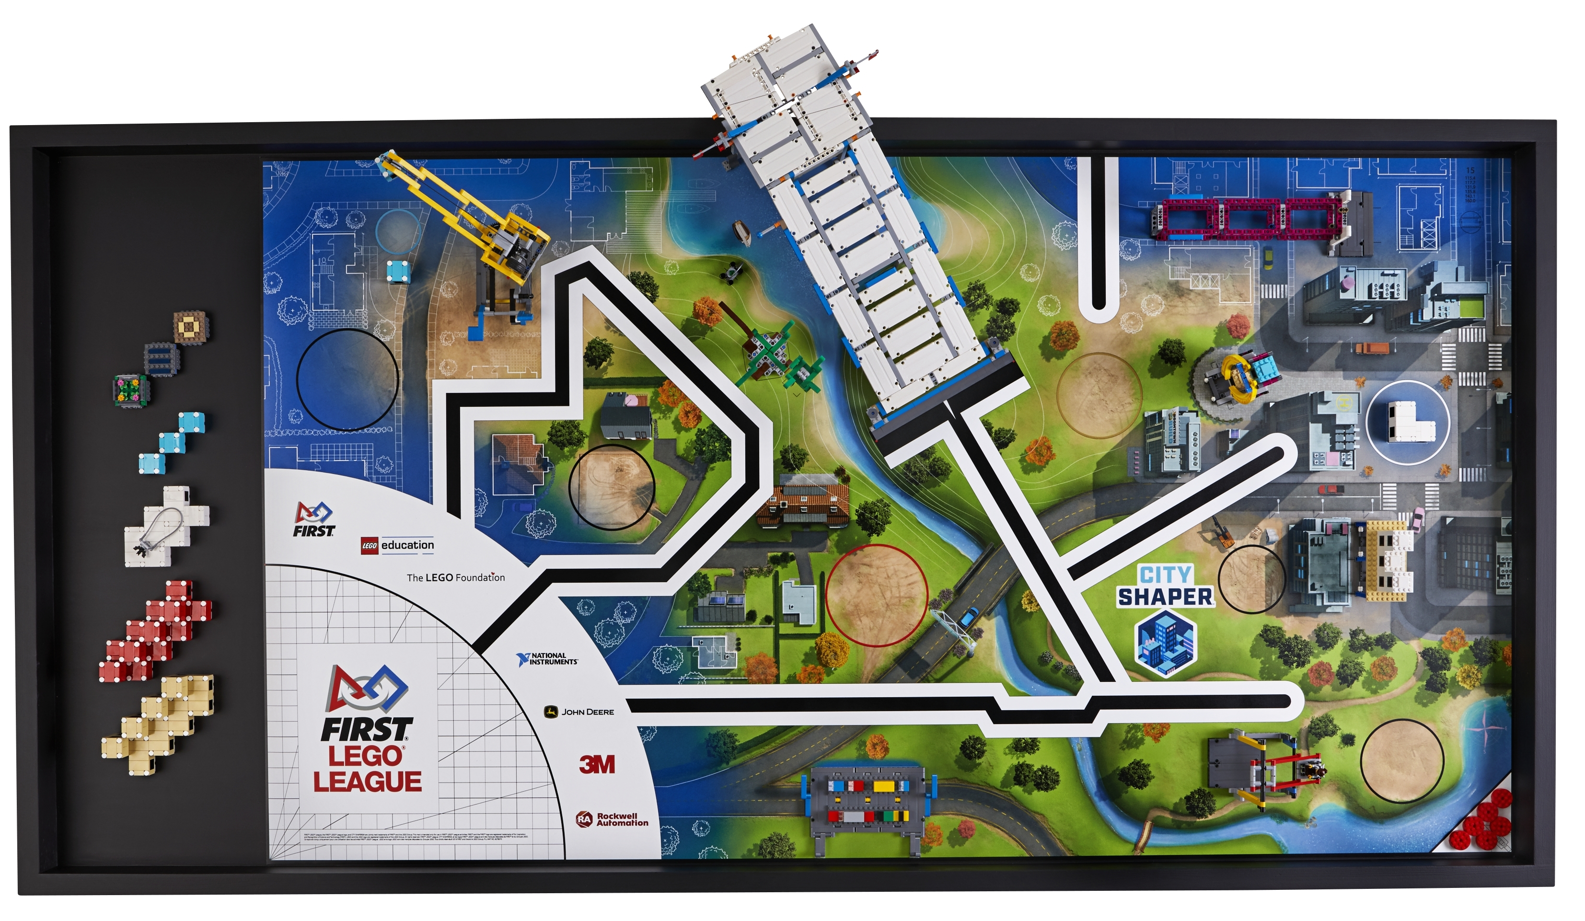
Strategy Planning Worksheet
Name:
Instructions:
Take a pen and trace out the path the robot will take each time it leaves the Launch Area (a new pen color for each path)
Decide which missions the robot might complete along that part and mark them with a circle
Determine the order in which the robot will go on the paths
Compare your strategy with others on the team.
Come to a consensus
Created by FLLTutorials.com, 2019

Slide 9
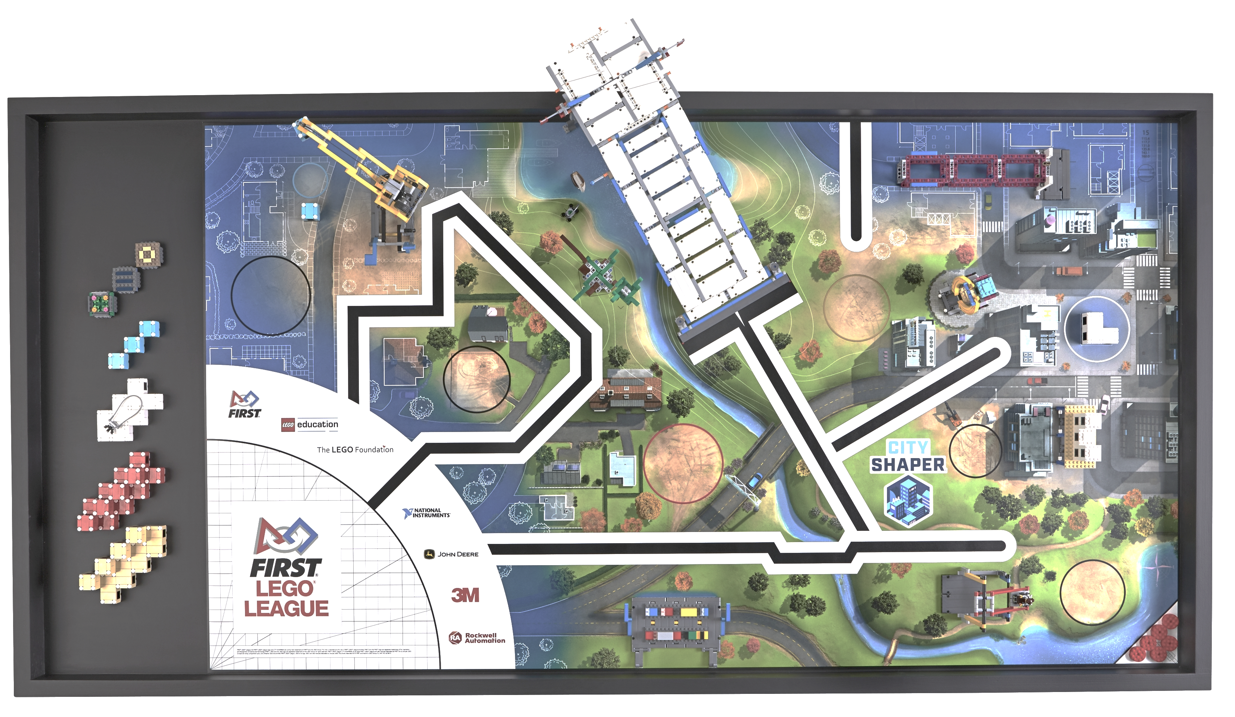
Strategy Planning Worksheet
Name:
Instructions:
Take a pen and trace out the path the robot will take each time it leaves the Launch Area (a new pen color for each path)
Decide which missions the robot might complete along that part and mark them with a circle
Determine the order in which the robot will go on the paths
Compare your strategy with others on the team.
Come to a consensus
Created by FLLTutorials.com, 2019

Slide 10
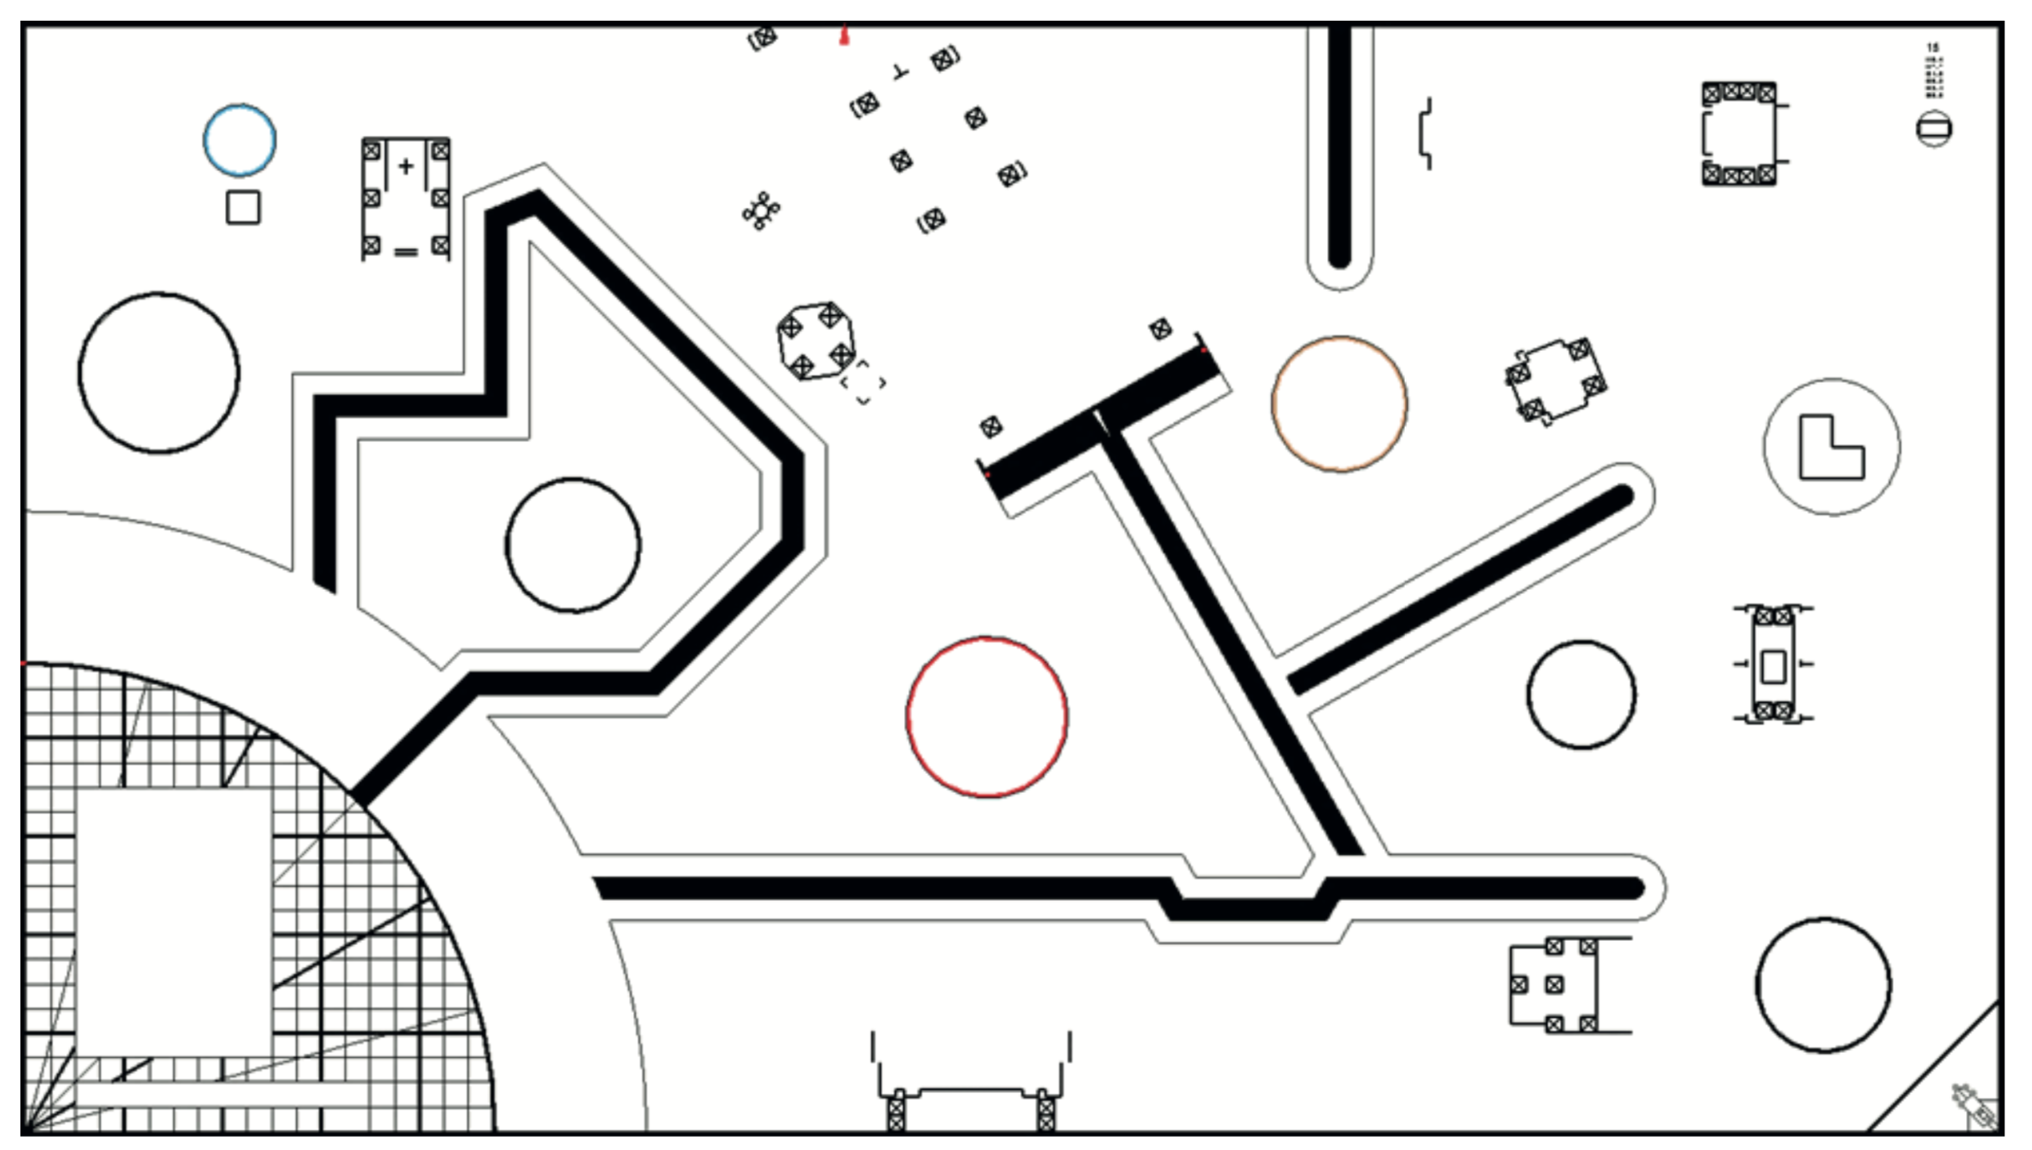
Strategy Planning Worksheet
Name:
Instructions:
Take a pen and trace out the path the robot will take each time it leaves the Launch Area (a new pen color for each path)
Decide which missions the robot might complete along that part and mark them with a circle
Determine the order in which the robot will go on the paths
Compare your strategy with others on the team.
Come to a consensus
Created by FLLTutorials.com, 2019

Slide 11
Robot Design Worksheet
Name:
Instructions:
Review the rules for the robot game. Are these any rules that will restrict your design? Is there a size limit? Method of activation that is required?
Think about all the missions your team decided to do. Will it need to go over something or reach high up?
Think about the paths your team decided to go on. Will it need to line follow? Where will it align?
Discuss with the rest of your team and then build a base robot to match the features you want and need.
What features should the robot have?
What sensors do we need?
What are some mechanisms that can solve the mission?
Created by FLLTutorials.com, 2019

Slide 12
Robot Testing Worksheet
Name:
Instructions:
If you design more than one robot, use this chart to compare them. At the top of each column, describe your robot
Come up with some basic tests to compare the robot designs. Can this robot move straight accurately? Can it turn consistently? Can it line follow? Can it detect a line? Did the robot move as intended?
Discuss which robot performed the best to help you pick the best design for your team.
 | Robot 1: Wheels: Size: Sensors: Motors: | Robot 2: Wheels: Size: Sensors: Motors: | Robot 3: Wheels: Size: Sensors: Motors:
Move Straight 50cm
Overall: Speed? Balance?
Created by FLLTutorials.com, 2019

Slide 13
Pseudocode Worksheet
Name:
Instructions:
Time to plan. For each path your team picked to go on, write out the pseudocode for the robot. Once the robot launches, how will it travel to the mission model and activate it? E.g. Move forward 30cm, turn 90 degrees left, etc
Write down each step the robot would take in plain English. Later, programmers can convert this into code
Add as many rows as needed
Step | Instruction
1
2
3
4
5
6
7
8
Created by FLLTutorials.com, 2019

Slide 14
Pseudocode Worksheet
Name:
Step | Instruction
Created by FLLTutorials.com, 2019

Slide 15

Project Selection Worksheet
Name:
Instructions: Read the text below and highlight and key words you think are important to this year’s project
CITY SHAPER Project Description:
Architects design and construct buildings. They combine science and art to make buildings and structures for their clients. Sometimes they make new buildings and sometimes they redesign old ones.
They work as part of a larger team, just like yours.
Structural, civil and environmental engineers make sure a project suits its site. Construction workers like electricians, plumbers and carpenters, and project managers make sure the job stays on time and within budget. Every role is important to get the job done.
Our cities and towns face big issues, like transportation, accessibility and even natural disasters. How can we shape a better future for everyone? It will take teamwork and imagination. Are you ready to build a better tomorrow together?
In the Innovation Project, your team will:
• Identify a problem with a building or public space in your community.
Design a solution.
Share your solution with others and then refine it.
Created by FLLTutorials.com, 2019

Slide 16
Project Selection Worksheet
Name:
Instructions:
Read the challenge and project description carefully
What problems do you know about related to the topic?
What experts can you talk to? What fieldtrips can you go on?
Share your ideas with your team members
Project Ideas/Problems
Field Trips
Experts
Created by FLLTutorials.com, 2019

Slide 17
Project Solution Worksheet
Name:
Instructions:
Once your team has picked a problem, think about how to solve it
What solutions exist already? How will your solution be different?
Can you make a prototype? Can you test the idea?
What solutions exist for this problem?
Can we solve the problem in a new or better way (easier/cheaper)?
How can we test the idea?
Created by FLLTutorials.com, 2019

Slide 18
Innovation Worksheet
Name:
Instructions:
Find as many similar products/solutions as you can find and compare them to your team’s solution
The goal is to gather enough information to be able to explain how the team’s solution is innovative (different or an improvement on something that exists). You can share all this information with your judges.
Product/Link | Costs | Implementation Process | Pros | Cons | Other
Our Solution
Created by FLLTutorials.com, 2019

Slide 19
Learn the Core Values
Name:
Instructions: Have each student fill in the form
Core Value | Definition | How will our team use this Core Value?
Discovery | We explore new skills and ideas. | 1. 2.
Innovation | We use creativity and persistence to solve problems. | 1. 2.
Impact | We apply what we learn to improve our world. | 1. 2.
Inclusion | We respect each other and embrace our differences. | 1. 2.
Teamwork | We are stronger when we work together. | 1. 2.
Fun | We enjoy and celebrate what we do! | 1. 2.
Created by FLLTutorials.com, 2019

Slide 20
Other Core Values-Related Concepts
Name:
Instructions: Have each student fill in the form
Core Value | Definition | How will our team use this Concept?
Coopertition | Learning is more important than winning; Team learns from, teaches, and cooperates with each other and competing teams | 1. 2.
Gracious Professionalism | Encourage high-quality work, value each other, and respect individuals and the community | 1. 2.
Kids Do the Work | Appropriate balance between team responsibility and coach guidance | 1. 2.
Created by FLLTutorials.com, 2019

